Slide 1

Finding location for residential construction investment in Boston
Alexander Iliyashov
August 2020
Notes:
This template can be used as a starter file for presenting training materials in a group setting.
Sections
Right-click on a slide to add sections. Sections can help to organize your slides or facilitate collaboration between multiple authors.
Notes
Use the Notes section for delivery notes or to provide additional details for the audience. View these notes in Presentation View during your presentation.
Keep in mind the font size (important for accessibility, visibility, videotaping, and online production)
Coordinated colors
Pay particular attention to the graphs, charts, and text boxes.
Consider that attendees will print in black and white or grayscale. Run a test print to make sure your colors work when printed in pure black and white and grayscale.
Graphics, tables, and graphs
Keep it simple: If possible, use consistent, non-distracting styles and colors.
Label all graphs and tables.

Slide 2
Agenda
Introduction of Business problem
Methodology
Analysis and results
Recommendations
Discussions
Conclusions
Notes:
Give a brief overview of the presentation. Describe the major focus of the presentation and why it is important.
Introduce each of the major topics.
To provide a road map for the audience, you can repeat this Overview slide throughout the presentation, highlighting the particular topic you will discuss next.

Slide 3
Introduction of Business problem
The aim of the project is to evaluate areas of Boston city and find attractive locations for residential construction
Safety and comfort of the area impacts interest to real estate from potential high-income buyers
Notes:
Give a brief overview of the presentation. Describe the major focus of the presentation and why it is important.
Introduce each of the major topics.
To provide a road map for the audience, you can repeat this Overview slide throughout the presentation, highlighting the particular topic you will discuss next.

Slide 4
Methodology
k-means clustering was used to identify clusters with the most developed infrastructure
Further exploratory analysis of criminal statistic was implemented to identify neighborhoods with developed infrastructure and low crime incidents rate
Venue and crime data was normalized across all Boston neighbourhoods to make it comparable
Notes:
Give a brief overview of the presentation. Describe the major focus of the presentation and why it is important.
Introduce each of the major topics.
To provide a road map for the audience, you can repeat this Overview slide throughout the presentation, highlighting the particular topic you will discuss next.

Slide 5
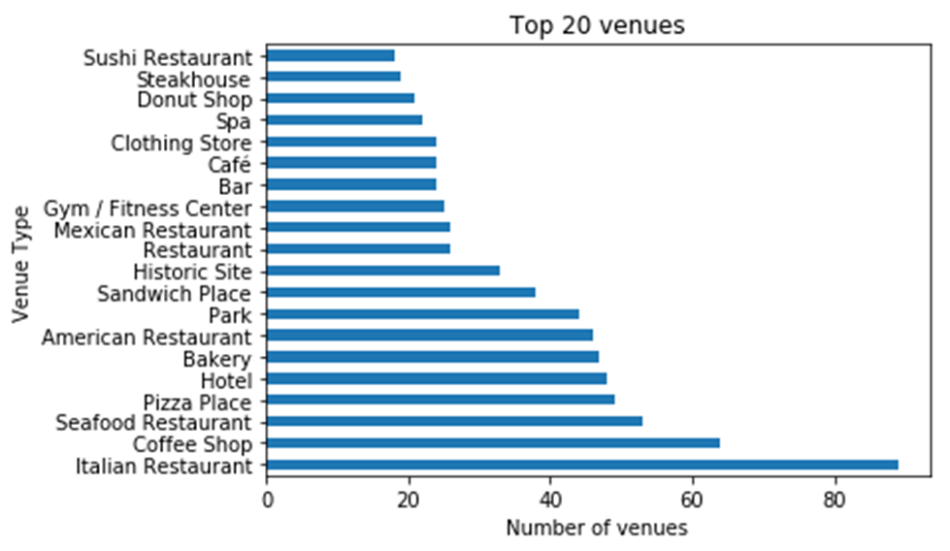
Analysis: Venues
Total number of venues provided by Foursquare database is ~1’600, mainly related to food category
Notes:
Give a brief overview of the presentation. Describe the major focus of the presentation and why it is important.
Introduce each of the major topics.
To provide a road map for the audience, you can repeat this Overview slide throughout the presentation, highlighting the particular topic you will discuss next.

Slide 6
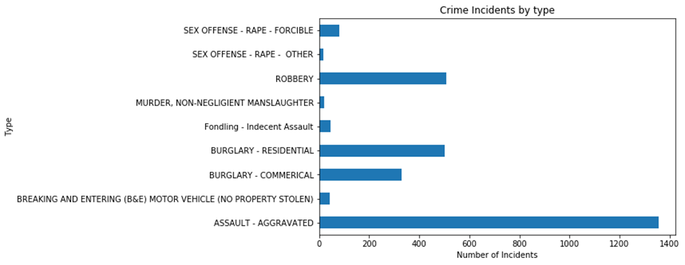
Analysis: Crimes
Total number of the criminal incidents for first seven month of 2020 is ~2’900. Majority of the incidents belong to Assault, Burglary and Robbery categories
Notes:
Give a brief overview of the presentation. Describe the major focus of the presentation and why it is important.
Introduce each of the major topics.
To provide a road map for the audience, you can repeat this Overview slide throughout the presentation, highlighting the particular topic you will discuss next.

Slide 7
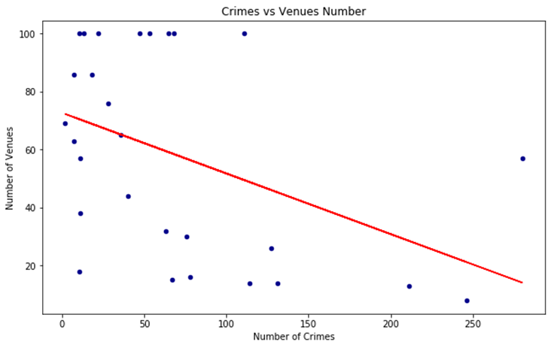
Analysis: Venues vs Crimes
There is negative correlation between number of Crimes and Number of Venues grouped by neighborhoods
Notes:
Give a brief overview of the presentation. Describe the major focus of the presentation and why it is important.
Introduce each of the major topics.
To provide a road map for the audience, you can repeat this Overview slide throughout the presentation, highlighting the particular topic you will discuss next.

Slide 8
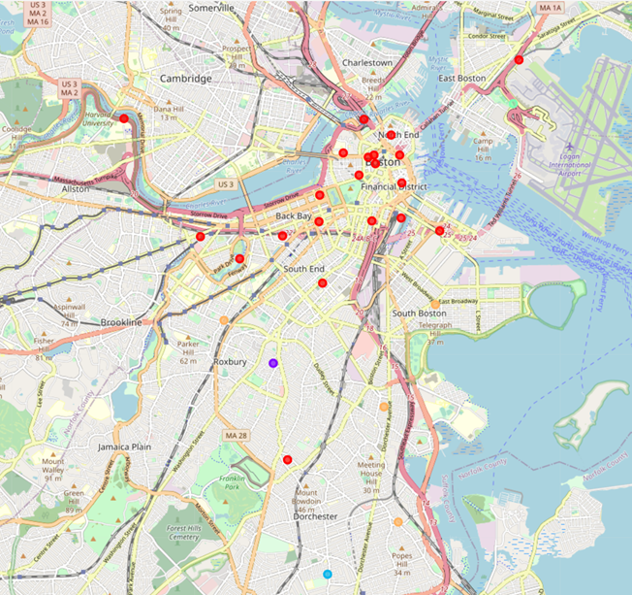
Analysis: Clustering
5 clusters K-means neighborhoods classification was implemented based on the venues information
Notes:
Give a brief overview of the presentation. Describe the major focus of the presentation and why it is important.
Introduce each of the major topics.
To provide a road map for the audience, you can repeat this Overview slide throughout the presentation, highlighting the particular topic you will discuss next.

Slide 9
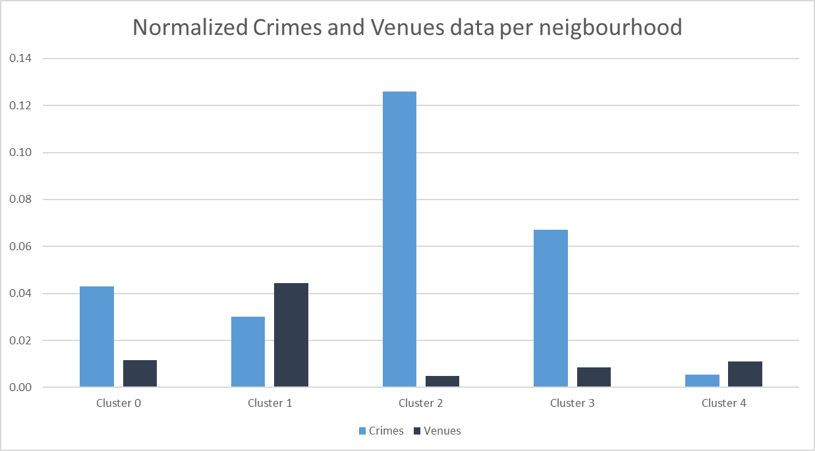
Analysis: Cluster Analysis
Group 1 (big) further analysis required
Group 2 (small) Cluster 2 and Cluster 3 have high crime rate and both Clusters were excluded from our analysis. Cluster 4 could be potentially targeted but it is located very close to airport and was excluded due to potential noise from the flights.
Number of neighbourhoods
per cluster
4
21
1
1
1
Notes:
Give a brief overview of the presentation. Describe the major focus of the presentation and why it is important.
Introduce each of the major topics.
To provide a road map for the audience, you can repeat this Overview slide throughout the presentation, highlighting the particular topic you will discuss next.

Slide 10
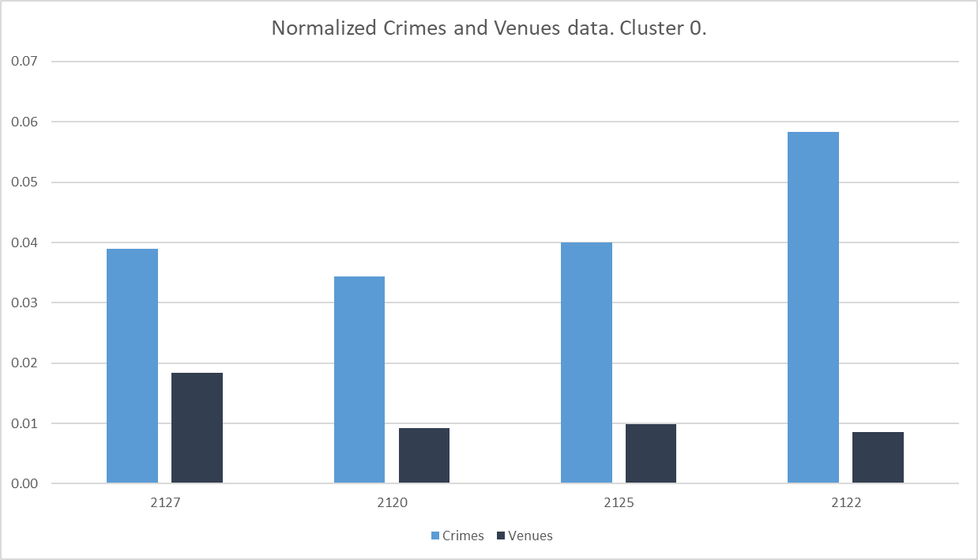
Analysis: Cluster 0
Situated mainly in the South of Boston in the distance of 1-2km from city center. Mainly low-rise residential area with bars, small restaurants and convenience stores
Relatively low number of venues and average crime rate
Boston average crime rate per neighbourhood 0.04%
Notes:
Give a brief overview of the presentation. Describe the major focus of the presentation and why it is important.
Introduce each of the major topics.
To provide a road map for the audience, you can repeat this Overview slide throughout the presentation, highlighting the particular topic you will discuss next.

Slide 11
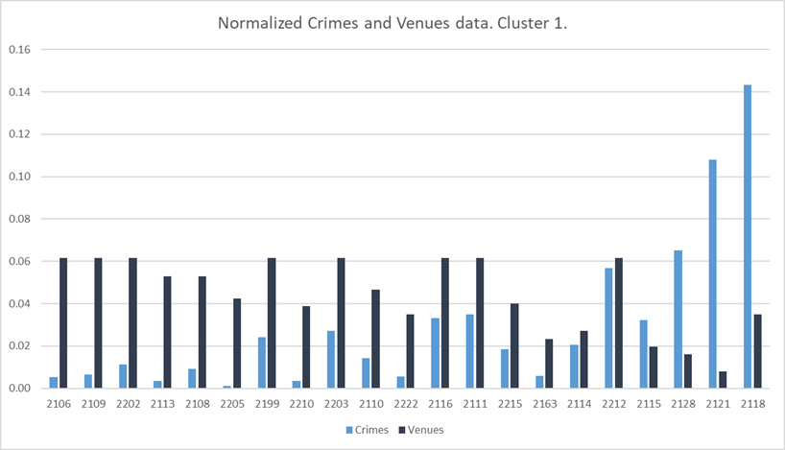
Analysis: Cluster 1
Situated in the North of Boston mainly in the center and close surroundings. in the Boston city center, close to the city center locations and close to Cambridge area. Mainly high-rise housing area with developed infrastructure.
Relatively high number of venues and varied crime rate
Boston average crime rate per neighbourhood 0.04%
Notes:
Give a brief overview of the presentation. Describe the major focus of the presentation and why it is important.
Introduce each of the major topics.
To provide a road map for the audience, you can repeat this Overview slide throughout the presentation, highlighting the particular topic you will discuss next.

Slide 12
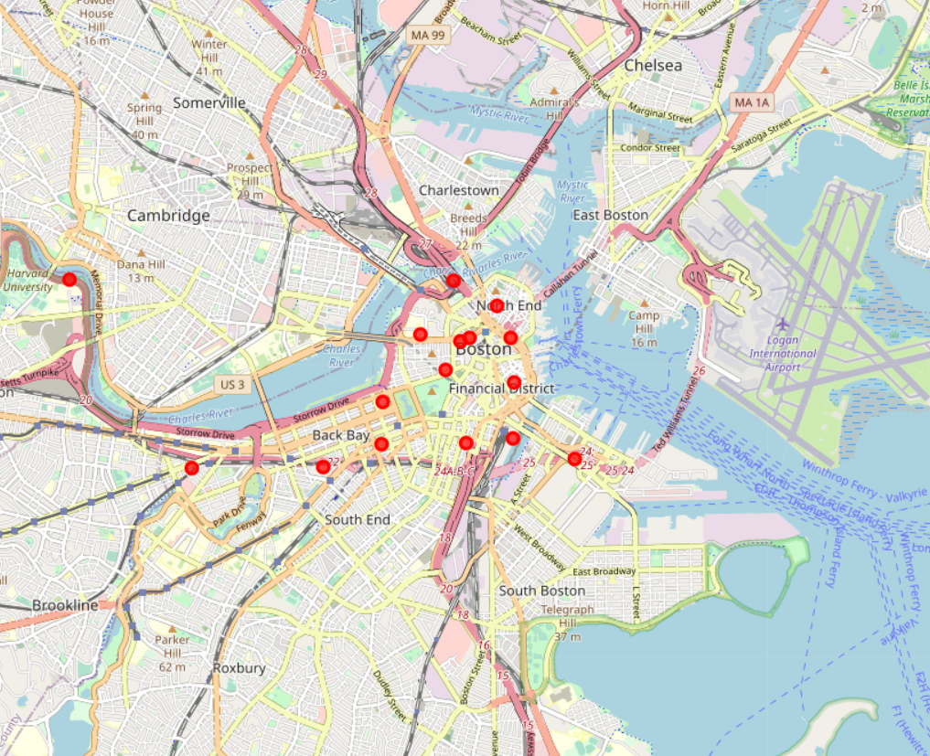
Recommendations
My recommendation to invest in the neigbourhoods selected on the next chart
Selection based on the relative ratio of venues vs crime rate
All selected neigbourhoods located in the Cluster 1 and close to Boston city center
Targeted neighbourhoods that could be considered for potential investments
Notes:
Give a brief overview of the presentation. Describe the major focus of the presentation and why it is important.
Introduce each of the major topics.
To provide a road map for the audience, you can repeat this Overview slide throughout the presentation, highlighting the particular topic you will discuss next.

Slide 13
Discussions
Potential actions for model improvement and further development:
Enhance analyzed data by
Retrieve more than 100 venues per location
Increase targeted area and include in to analysis Boston surroundings
Test methodology with another big city
Change Nominatim for paid geolocator to speed up identification of coordinates
Incorporate crime data in k-means analysis and set up one k-means model
Analyze further features that could impact attractiveness for investments (hosing price, public transport availability, etc.)
Notes:
Give a brief overview of the presentation. Describe the major focus of the presentation and why it is important.
Introduce each of the major topics.
To provide a road map for the audience, you can repeat this Overview slide throughout the presentation, highlighting the particular topic you will discuss next.

Slide 14
Conclusion
In my study I analyzed neigbourhoods of Boston city.
K-means combined with exploratory analysis was applied to identify potentially attractive neighbourhoods for investments in residential construction. Potential attractive locations were successfully identified.
This model should be used as one of the component of the more complex analysis that should include other relevant to investment attractiveness parameters.
This model could be applied for other location to solve similar problems.
Notes:
Give a brief overview of the presentation. Describe the major focus of the presentation and why it is important.
Introduce each of the major topics.
To provide a road map for the audience, you can repeat this Overview slide throughout the presentation, highlighting the particular topic you will discuss next.

Slide 15
Introduction of Business problem
The aim of the project is to evaluate areas of Boston city and find attractive locations for residential construction
Safety and comfort of the area impacts interest to real estate from potential high-income buyers
Notes:
Give a brief overview of the presentation. Describe the major focus of the presentation and why it is important.
Introduce each of the major topics.
To provide a road map for the audience, you can repeat this Overview slide throughout the presentation, highlighting the particular topic you will discuss next.

Slide 16
Methodology
k-means clustering was used to identify clusters with the most developed infrastructure
Further exploratory analysis of criminal statistic was implemented to identify neighborhoods with developed infrastructure and low crime incidents rate
Venue and crime data was normalized across all Boston neighbourhoods to make it comparable
Notes:
Give a brief overview of the presentation. Describe the major focus of the presentation and why it is important.
Introduce each of the major topics.
To provide a road map for the audience, you can repeat this Overview slide throughout the presentation, highlighting the particular topic you will discuss next.

Slide 17
Analysis: Venues
Total number of venues provided by Foursquare database is ~1’600, mainly related to food category
Notes:
Give a brief overview of the presentation. Describe the major focus of the presentation and why it is important.
Introduce each of the major topics.
To provide a road map for the audience, you can repeat this Overview slide throughout the presentation, highlighting the particular topic you will discuss next.

Slide 18
Analysis: Crimes
Total number of the criminal incidents for first seven month of 2020 is ~2’900. Majority of the incidents belong to Assault, Burglary and Robbery categories
Notes:
Give a brief overview of the presentation. Describe the major focus of the presentation and why it is important.
Introduce each of the major topics.
To provide a road map for the audience, you can repeat this Overview slide throughout the presentation, highlighting the particular topic you will discuss next.

Slide 19
Analysis: Venues vs Crimes
There is negative correlation between number of Crimes and Number of Venues grouped by neighborhoods
Notes:
Give a brief overview of the presentation. Describe the major focus of the presentation and why it is important.
Introduce each of the major topics.
To provide a road map for the audience, you can repeat this Overview slide throughout the presentation, highlighting the particular topic you will discuss next.

Slide 20
Analysis: Clustering
5 clusters K-means neighborhoods classification was implemented based on the venues information
Notes:
Give a brief overview of the presentation. Describe the major focus of the presentation and why it is important.
Introduce each of the major topics.
To provide a road map for the audience, you can repeat this Overview slide throughout the presentation, highlighting the particular topic you will discuss next.

Slide 21
Analysis: Cluster Analysis
Group 1 (big) further analysis required
Group 2 (small) Cluster 2 and Cluster 3 have high crime rate and both Clusters were excluded from our analysis. Cluster 4 could be potentially targeted but it is located very close to airport and was excluded due to potential noise from the flights.
Number of neighbourhoods
per cluster
4
21
1
1
1
Notes:
Give a brief overview of the presentation. Describe the major focus of the presentation and why it is important.
Introduce each of the major topics.
To provide a road map for the audience, you can repeat this Overview slide throughout the presentation, highlighting the particular topic you will discuss next.

Slide 22
Analysis: Cluster 0
Situated mainly in the South of Boston in the distance of 1-2km from city center. Mainly low-rise residential area with bars, small restaurants and convenience stores
Relatively low number of venues and average crime rate
Boston average crime rate per neighbourhood 0.04%
Notes:
Give a brief overview of the presentation. Describe the major focus of the presentation and why it is important.
Introduce each of the major topics.
To provide a road map for the audience, you can repeat this Overview slide throughout the presentation, highlighting the particular topic you will discuss next.

Slide 23
Analysis: Cluster 1
Situated in the North of Boston mainly in the center and close surroundings. in the Boston city center, close to the city center locations and close to Cambridge area. Mainly high-rise housing area with developed infrastructure.
Relatively high number of venues and varied crime rate
Boston average crime rate per neighbourhood 0.04%
Notes:
Give a brief overview of the presentation. Describe the major focus of the presentation and why it is important.
Introduce each of the major topics.
To provide a road map for the audience, you can repeat this Overview slide throughout the presentation, highlighting the particular topic you will discuss next.

Slide 24
Recommendations
My recommendation to invest in the neigbourhoods selected on the next chart
Selection based on the relative ratio of venues vs crime rate
All selected neigbourhoods located in the Cluster 1 and close to Boston city center
Targeted neighbourhoods that could be considered for potential investments
Notes:
Give a brief overview of the presentation. Describe the major focus of the presentation and why it is important.
Introduce each of the major topics.
To provide a road map for the audience, you can repeat this Overview slide throughout the presentation, highlighting the particular topic you will discuss next.

Slide 25
Discussions
Potential actions for model improvement and further development:
Enhance analyzed data by
Retrieve more than 100 venues per location
Increase targeted area and include in to analysis Boston surroundings
Test methodology with another big city
Change Nominatim for paid geolocator to speed up identification of coordinates
Incorporate crime data in k-means analysis and set up one k-means model
Analyze further features that could impact attractiveness for investments (hosing price, public transport availability, etc.)
Notes:
Give a brief overview of the presentation. Describe the major focus of the presentation and why it is important.
Introduce each of the major topics.
To provide a road map for the audience, you can repeat this Overview slide throughout the presentation, highlighting the particular topic you will discuss next.

Slide 26
Conclusions
In my study I analyzed neigbourhoods of Boston city.
K-means combined with exploratory analysis was applied to identify potentially attractive neighbourhoods for investments in residential construction. Potential attractive locations were successfully identified.
This model should be used as one of the component of the more complex analysis that should include other relevant to investment attractiveness parameters.
This model could be applied for other location to solve similar problems.
Notes:
Give a brief overview of the presentation. Describe the major focus of the presentation and why it is important.
Introduce each of the major topics.
To provide a road map for the audience, you can repeat this Overview slide throughout the presentation, highlighting the particular topic you will discuss next.

